Slide 1


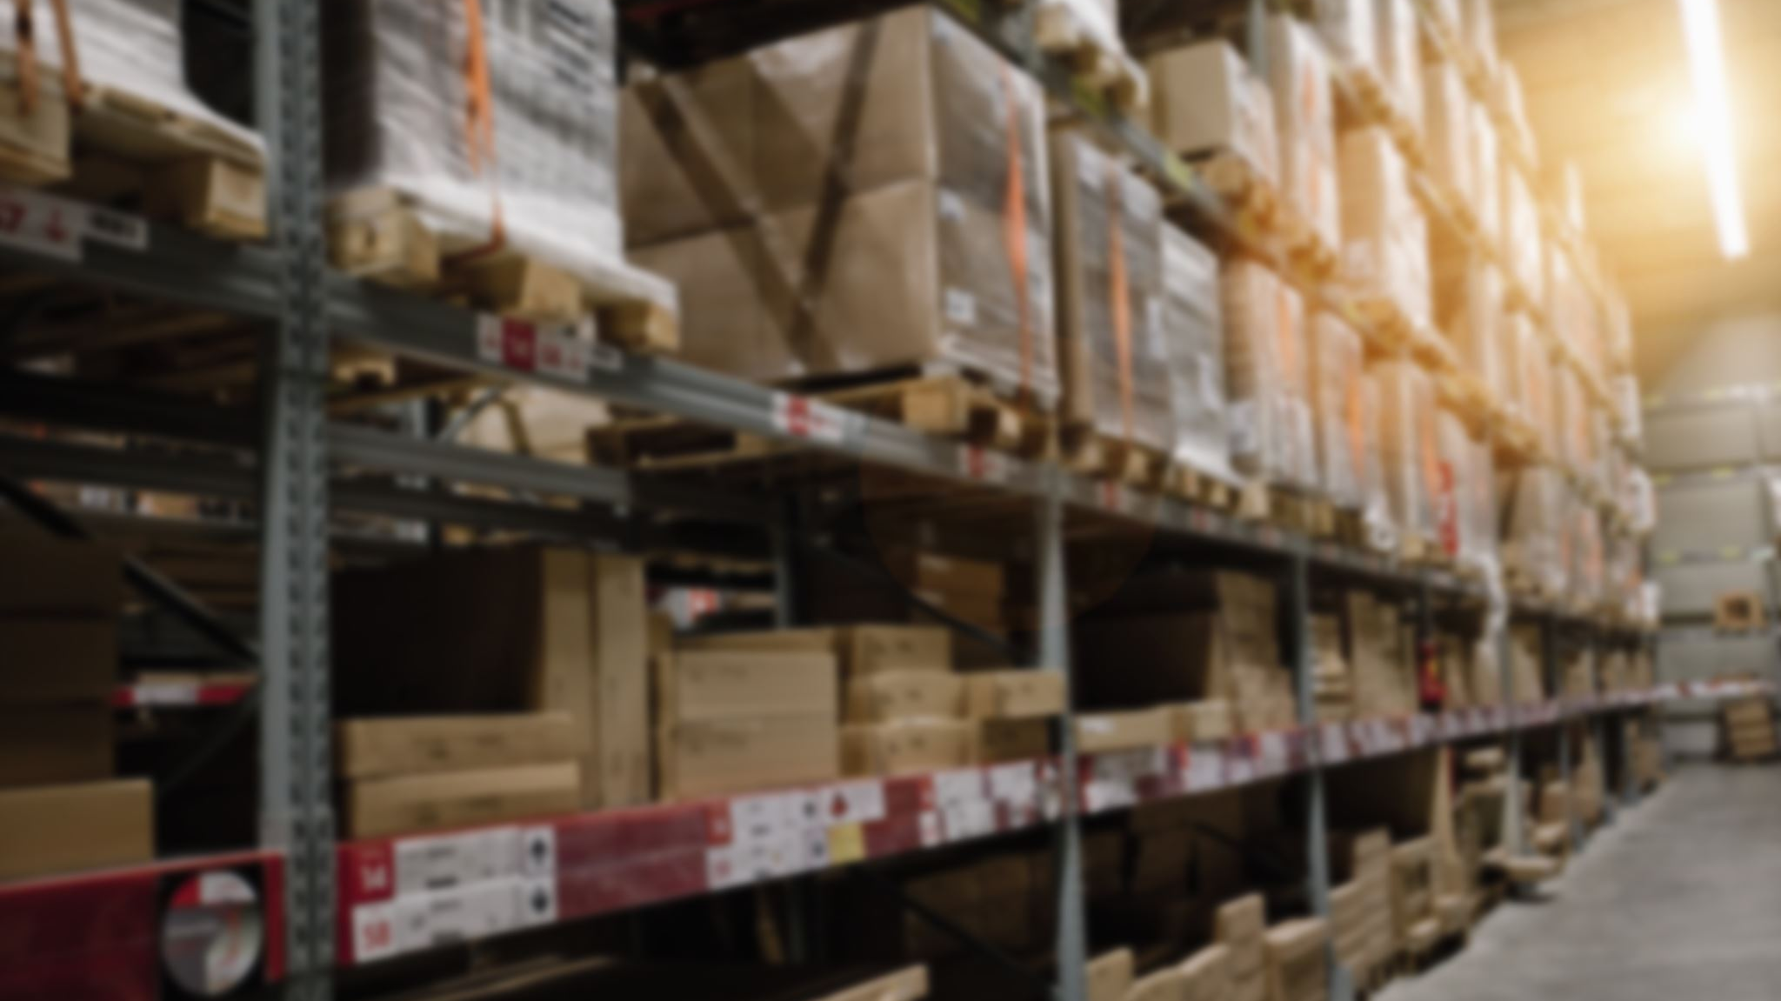
Arrays

Slide 2
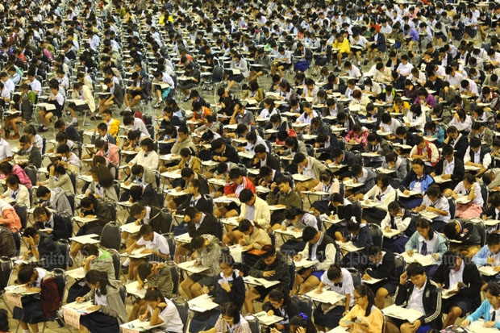
WHY arrays
Need to store a large number of values of an identical data types
For instance:
To store the marks of all the students of a university, you need to declare thousands of variables. In addition, all of them must be unique.
Is this Convenient?

Slide 3
One dimensional arrays
Definition: An array is a data structure containing a number of data values, all of which have the same data type
These values, known as elements, can be individually selected by their position within the array.
Simplest kind of array is One-Dimensional Array
Generally, size of the array is fixed

Slide 4


Array declaration

Slide 5


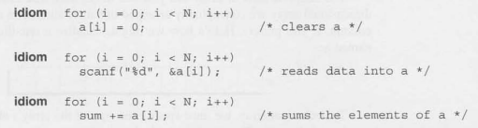
Array subscripting
Note:
Combination of an
Array name and its
Index works like a variable

Slide 6
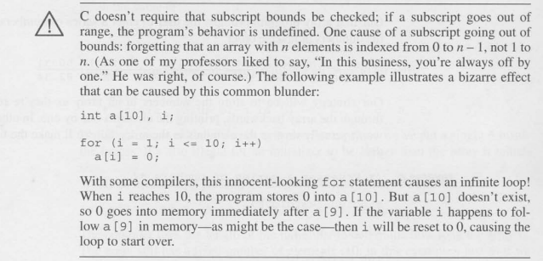
attention

Slide 7
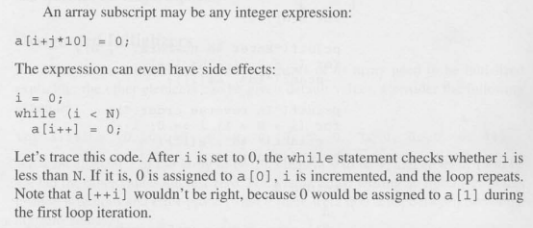
Some more discussions

Slide 8
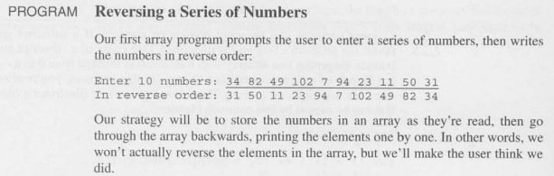
Practice problem 1
Shifting the Array values to one cell right ….

Slide 9

Array initialization

Slide 10
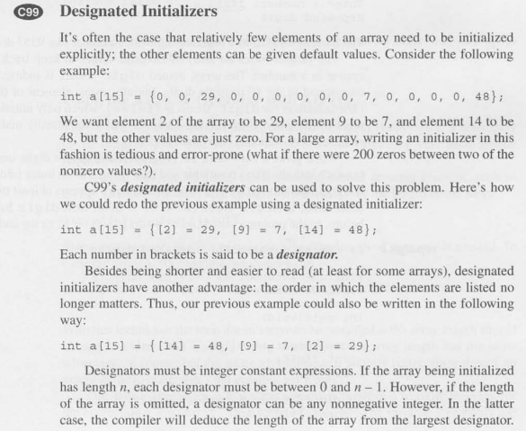
Designated initialization

Slide 11
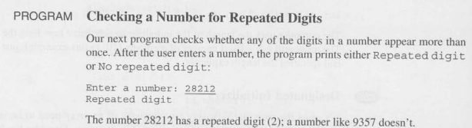
Practice Problem 2

Slide 12
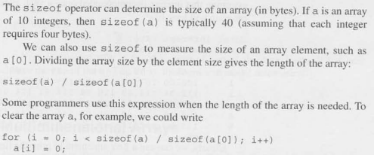
Using the size of operator

Slide 13
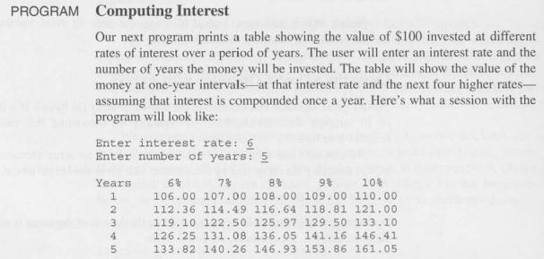
Practice problem 3

Slide 14
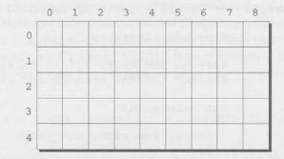

Multidimensional array

Slide 15






Initializing multidimensional array

Slide 16
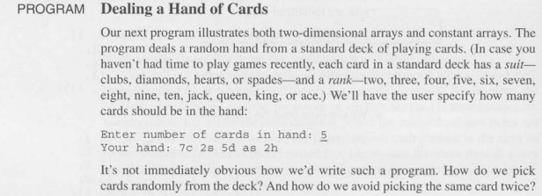
Practice problem 3

Slide 17

Variable length array (C99)

Slide 18
The END

